Slide 1
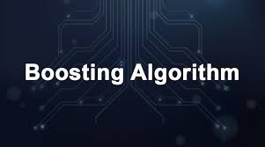

NAME: S.YOGANA

Slide 2
ENSEMBLE LEARNING BAGGING BOOSTING

Slide 3
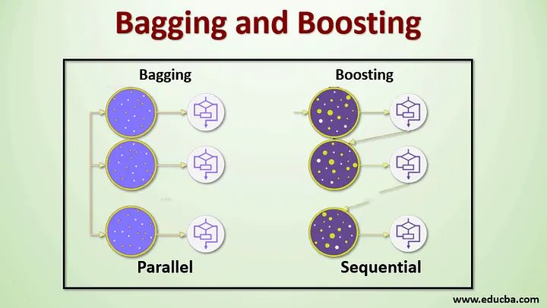
DATASET
DATASET

Slide 4
TYPES OF BOOSTING
ADA BOOSTING
XG BOOSTING
LG BOOSTING

Slide 5
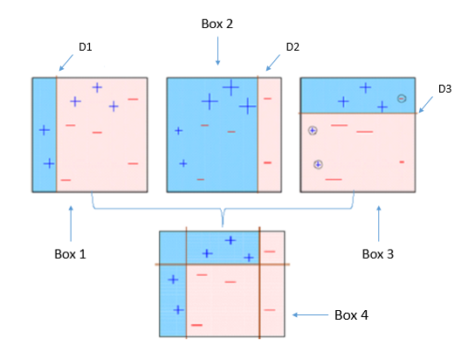
ADA BOOSTING
IT IS CALLED ADAPTIVE BOOSTING
TRANSFORMING WEAK
LEARNERS INTO STRONG LEARNER
BOTH REGRESSION AND CLASSIFICATION
PROBLEM SOLVED IN THIS ALGORITHM

Slide 6


XG BOOSTING
IT IS CALLED EXTREME GRADIENT BOOSTING
DISTRIBUTE MACHINE LEARNING PROCESS
XG BOOSTING IS FASTING AND GIVE ACCURATE
VALUE WITH GOOD MODEL.
OTHER BOOSTING
XG BOOST

Slide 7
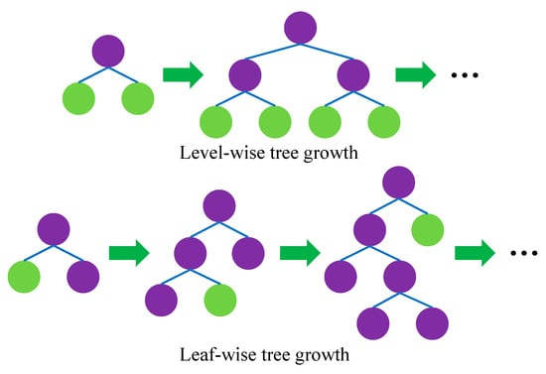
LG BOOSTING
IT IS CALLED BY LIGHT GRADIENT BOOSTING.
LARGE AMOUNT OF DATA IS EASY HANDLED.
THE SMALL DATASET IS GIVE POOR MODEL.
LG BOOSTING IS LEAF WISE GROWTH.
HISTOGRAM BASED METHOD
CONTINUOUS VALUES SPLITS UP TO BIN.

